Slide 1
Regular Relations and Finite-State Morphology: Regular expressions, finite-state automata, and transducers for morphological analysis

Slide 2
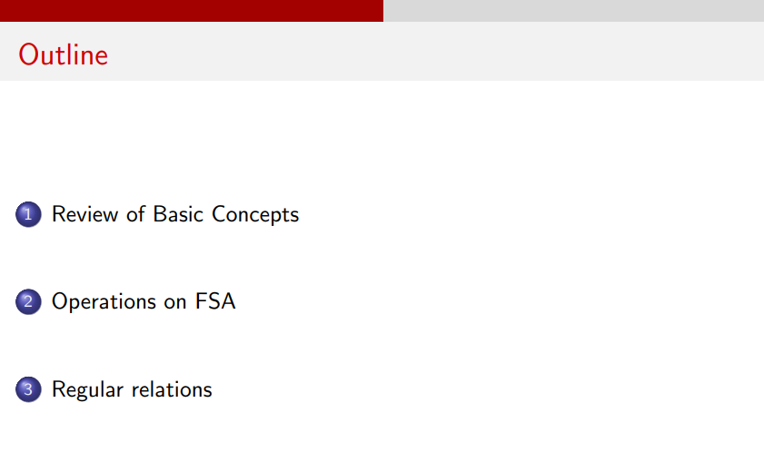

Slide 3
Note: The problems have been solved in the notebook. Please refer to it.

Slide 4
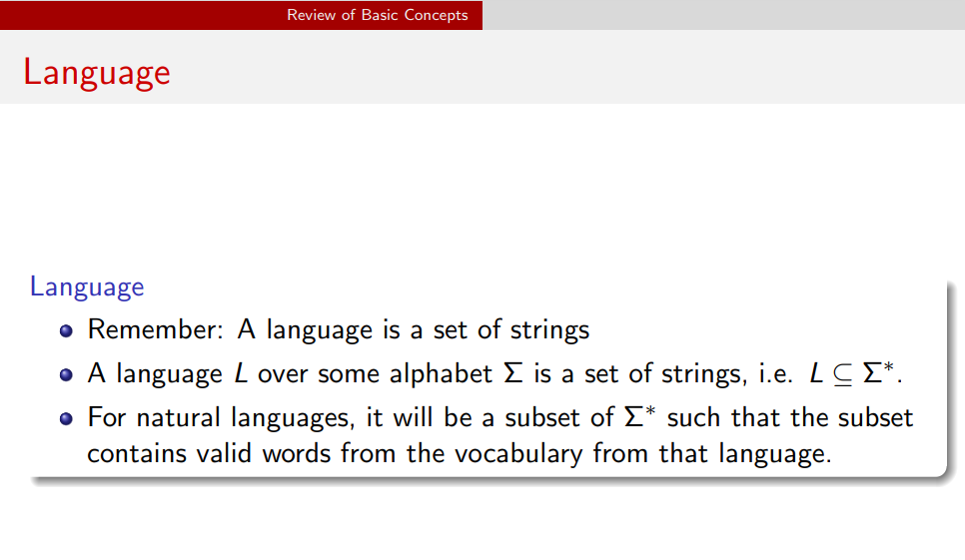

Slide 5
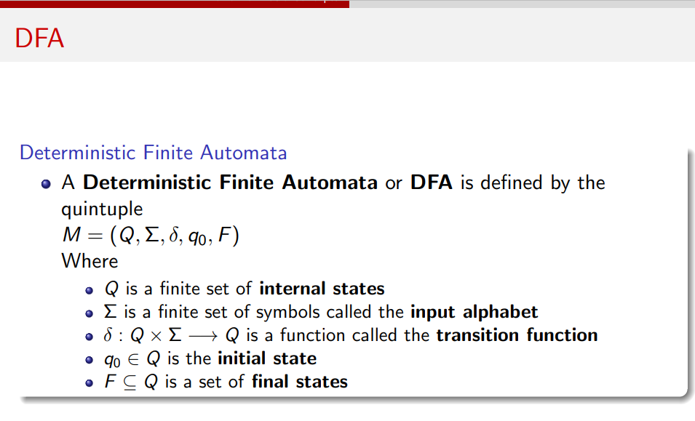

Slide 6
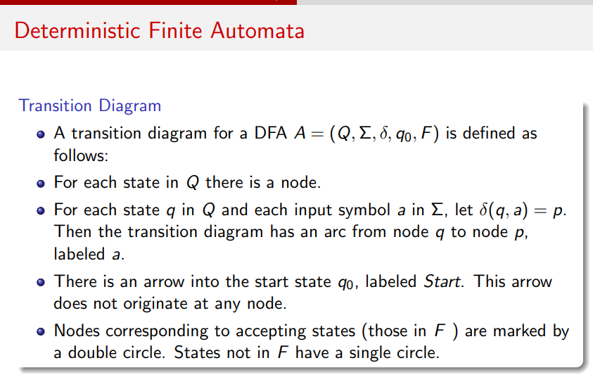

Slide 7
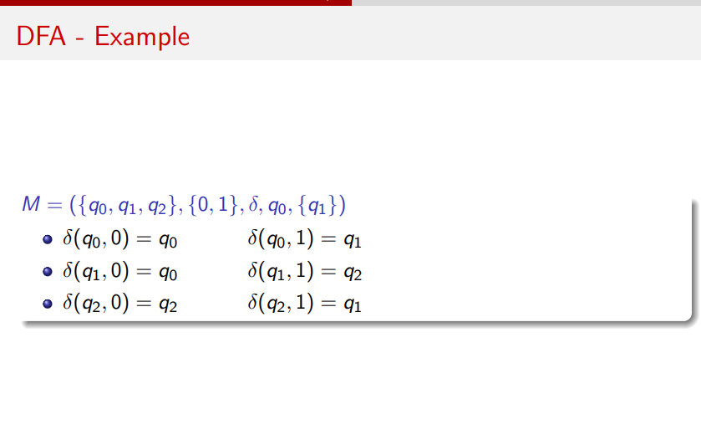

Slide 8
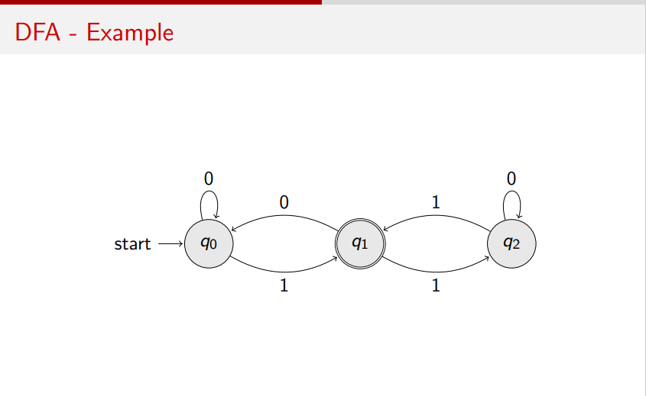

Slide 9
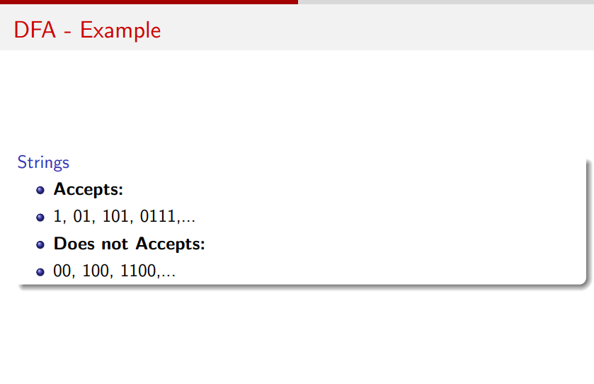

Slide 10
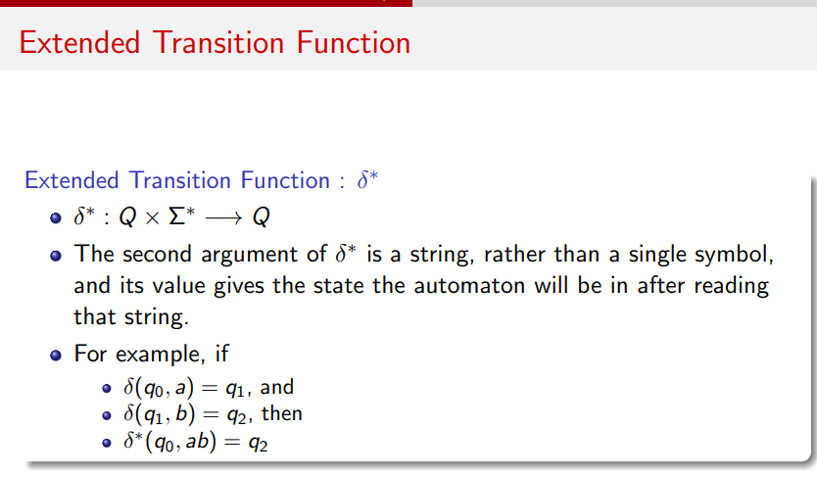

Slide 11
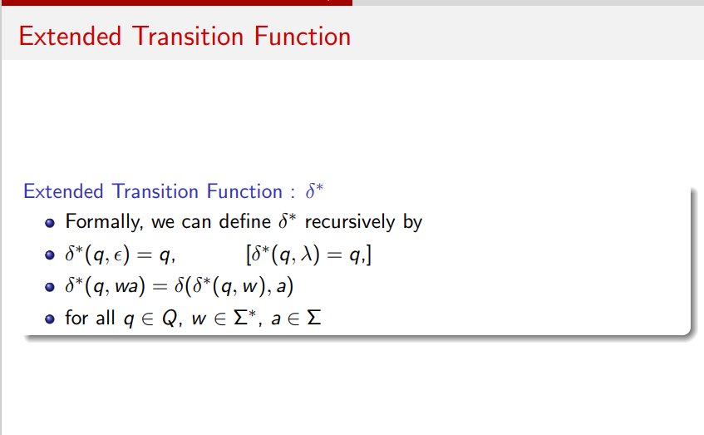

Slide 12
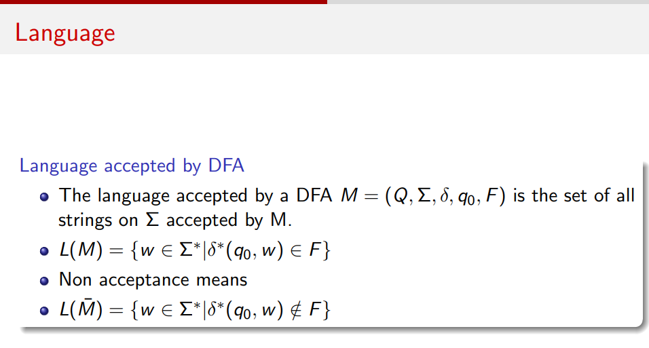

Slide 13
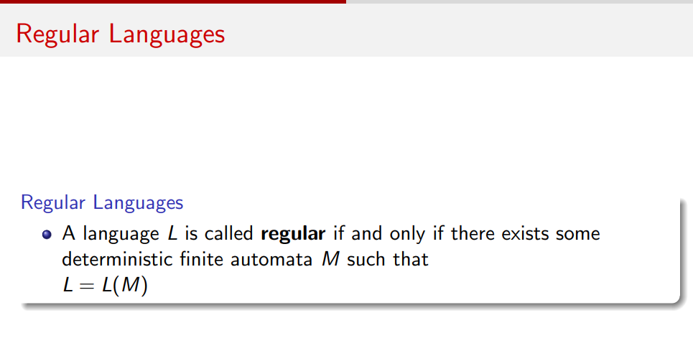
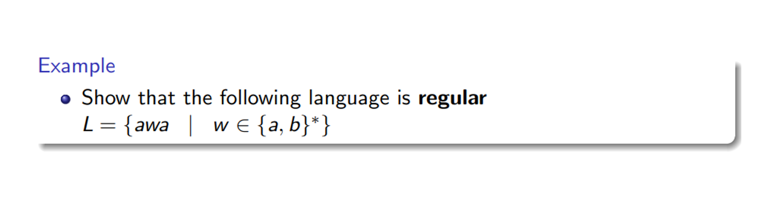

Slide 14
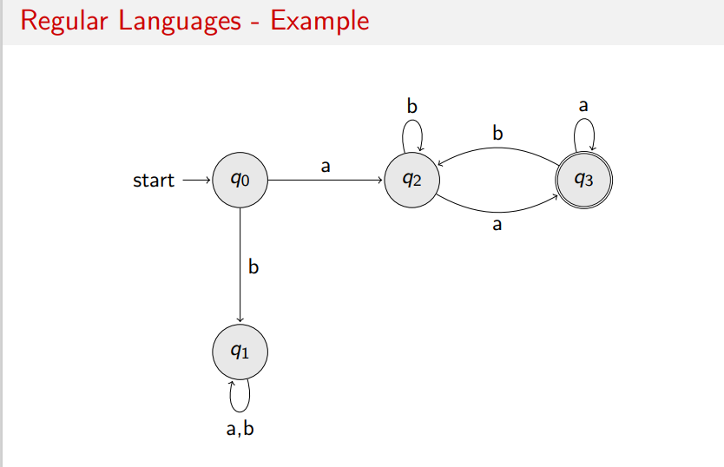

Slide 15
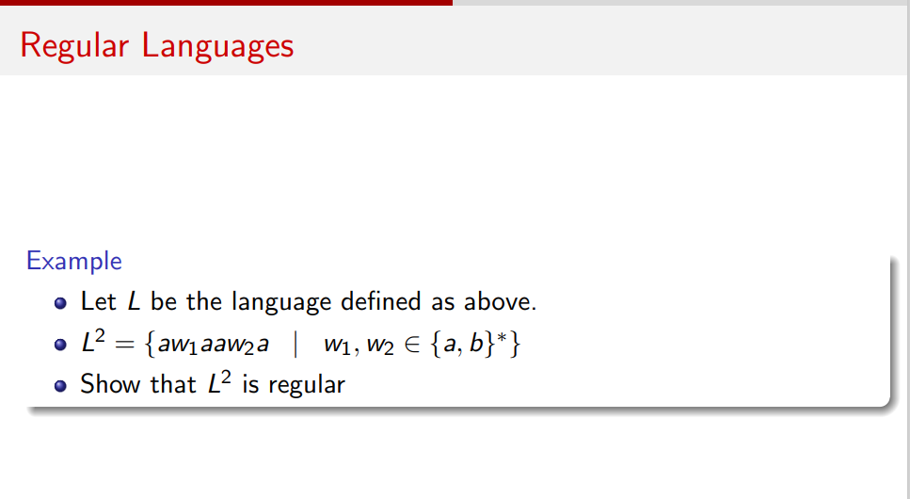

Slide 16
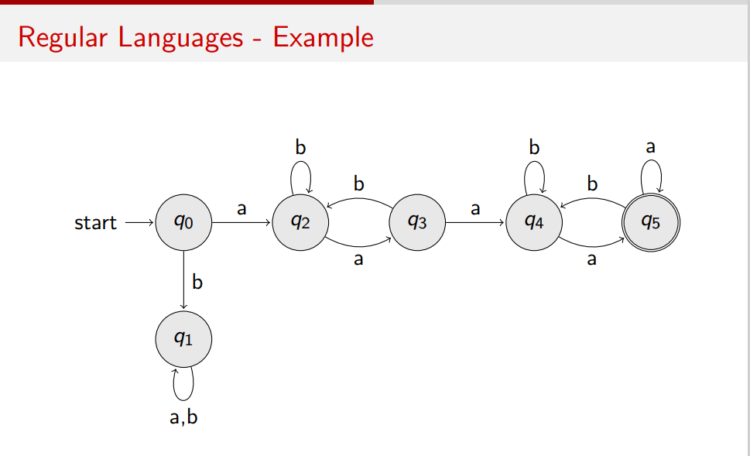

Slide 17
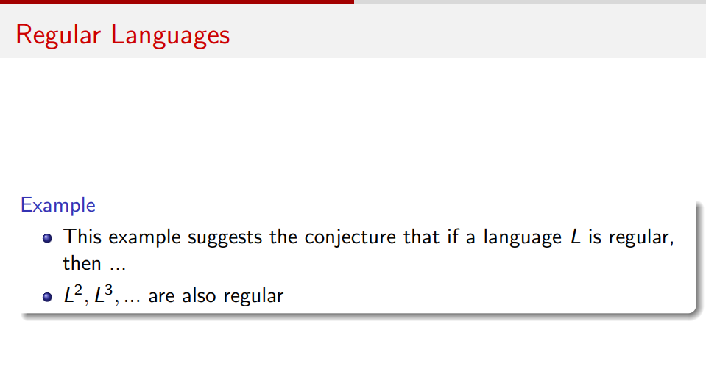

Slide 18
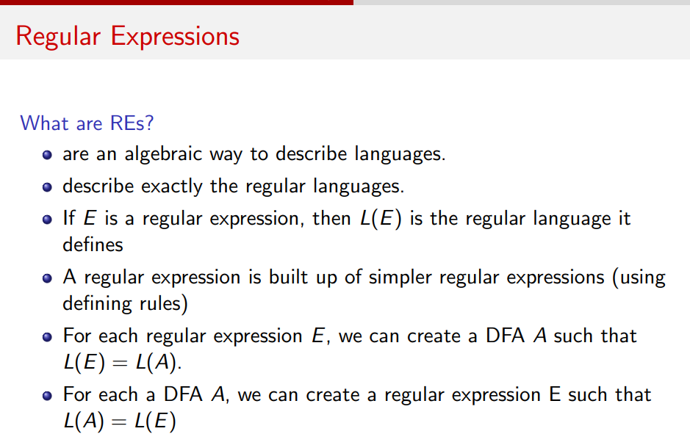

Slide 19
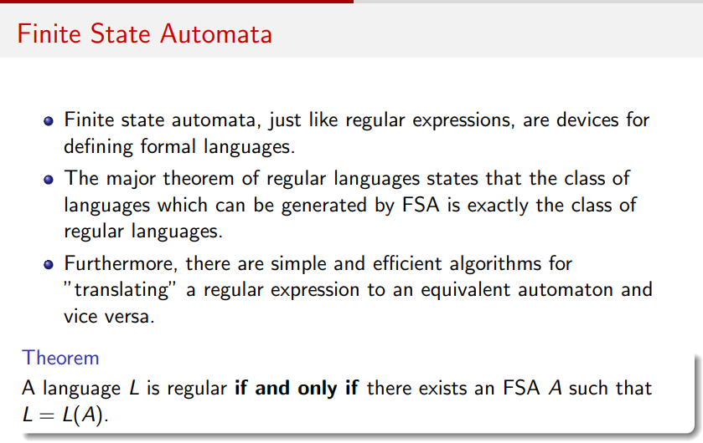

Slide 20
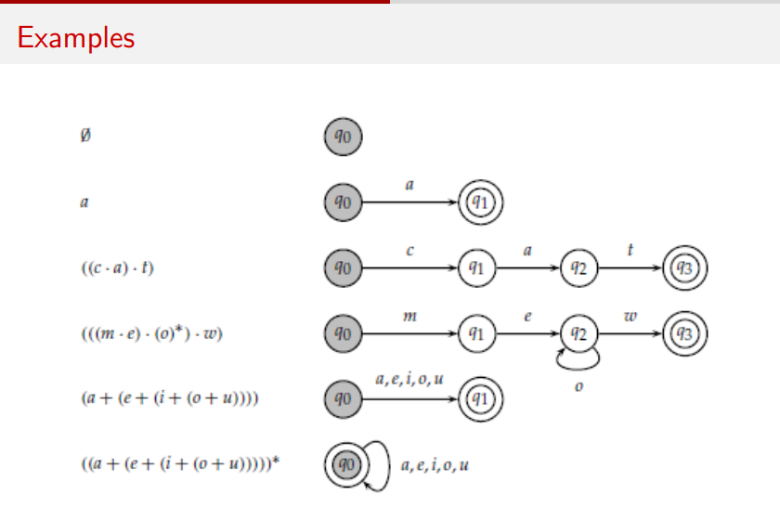

Slide 21
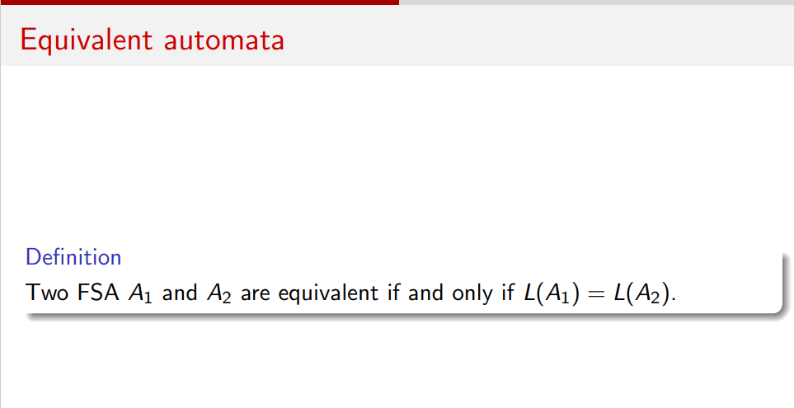

Slide 22
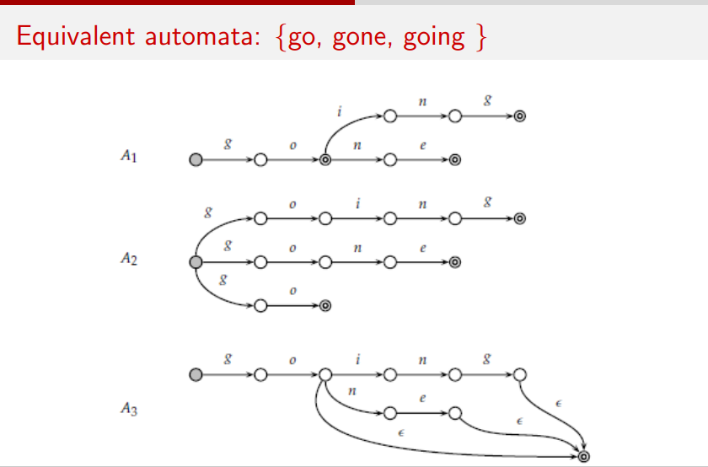

Slide 23
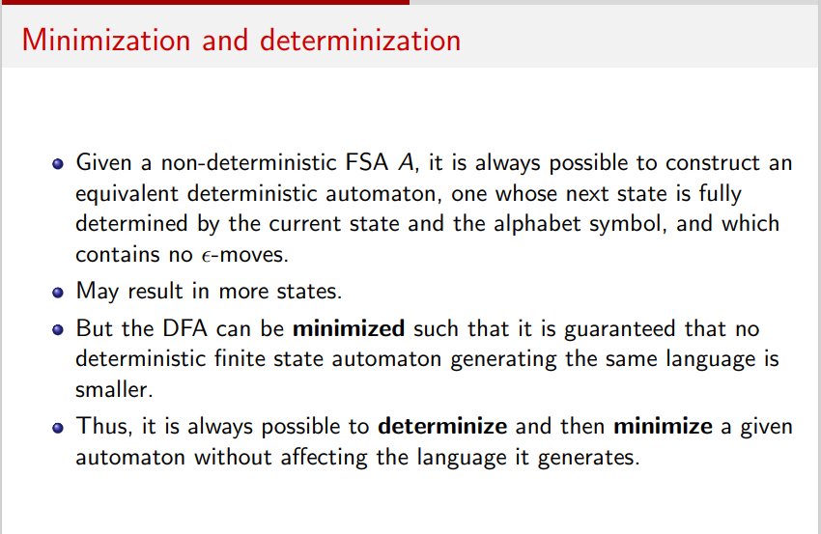

Slide 24
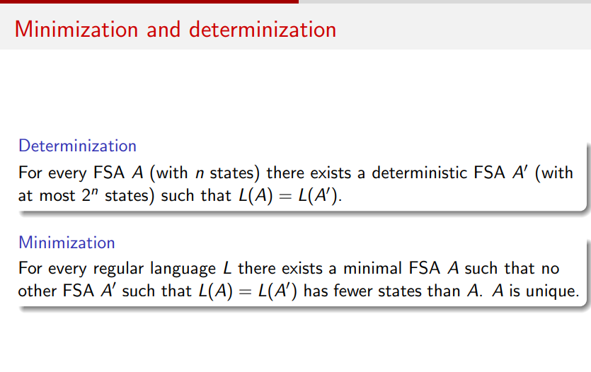

Slide 25
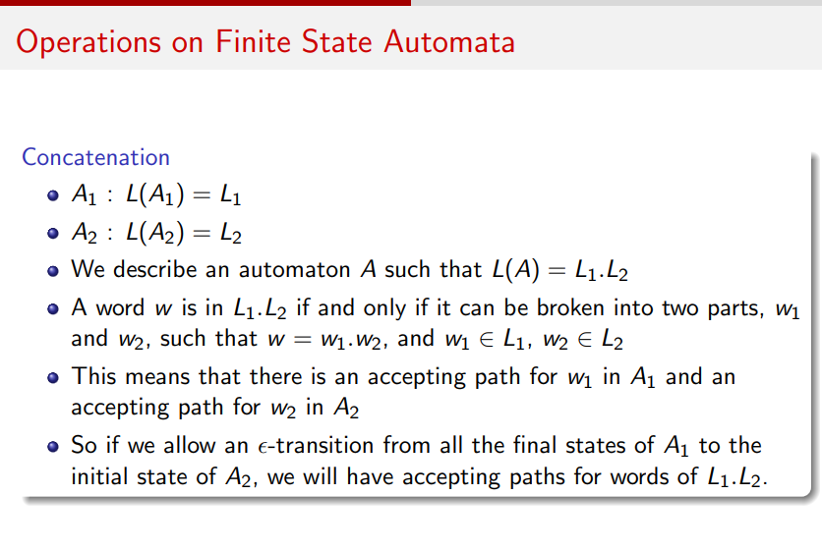

Slide 26
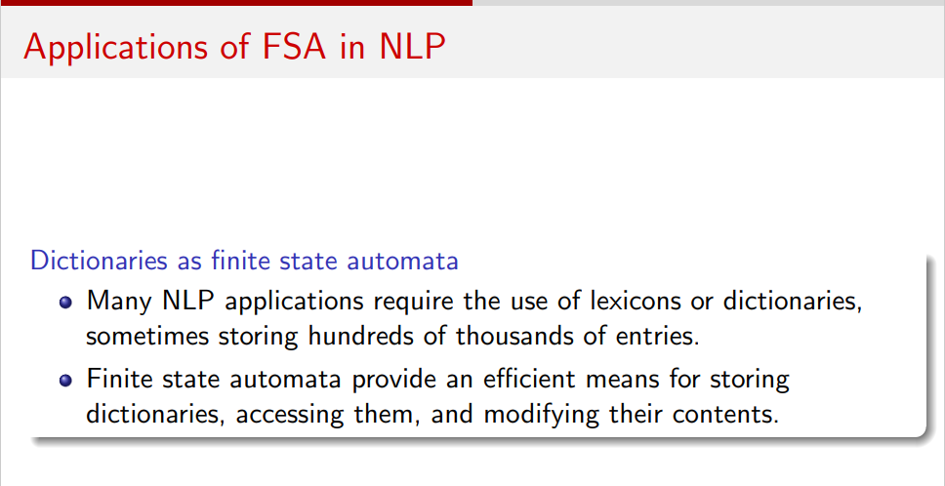

Slide 27
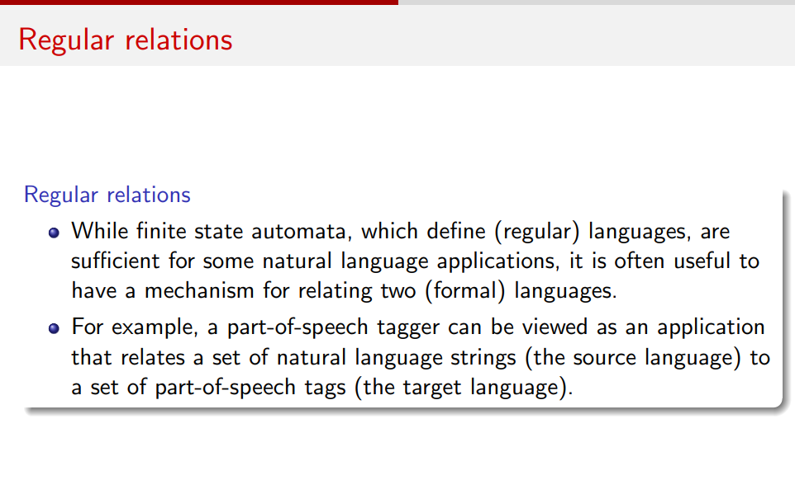

Slide 28
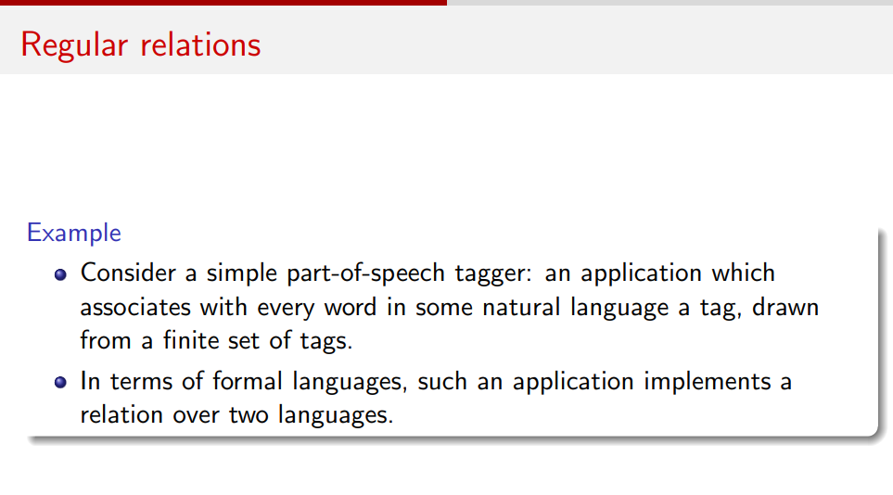

Slide 29
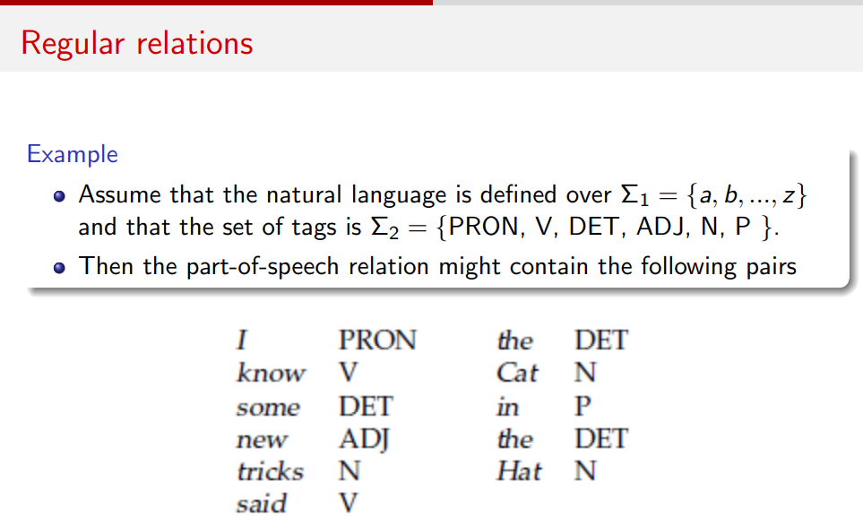

Slide 30
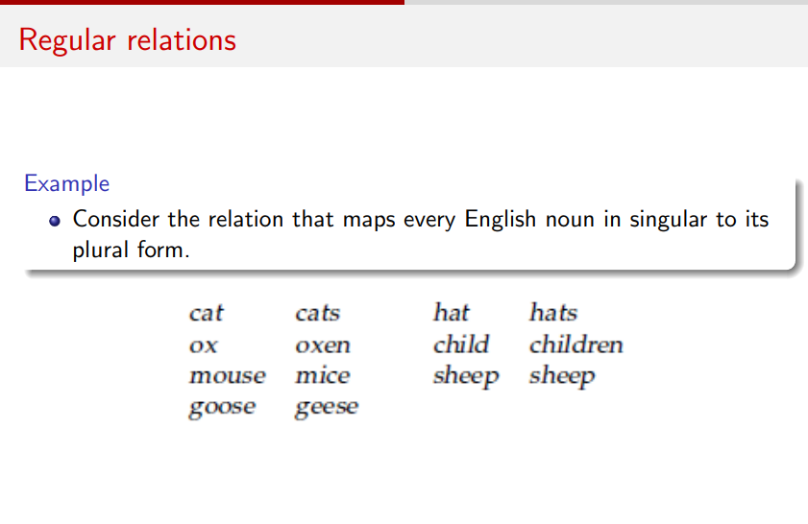

Slide 31
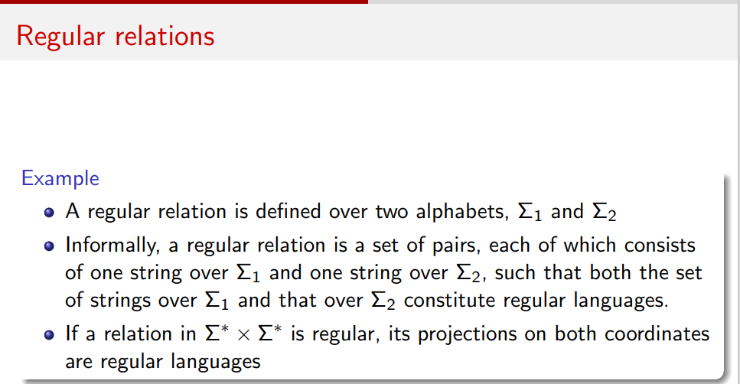

Slide 32
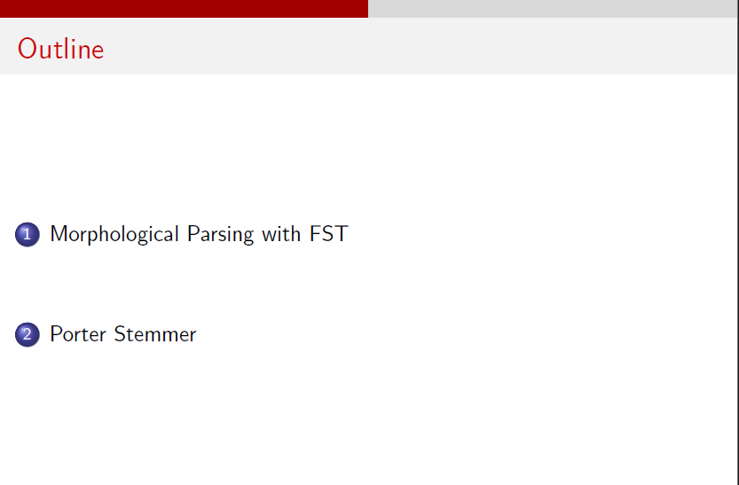

Slide 33
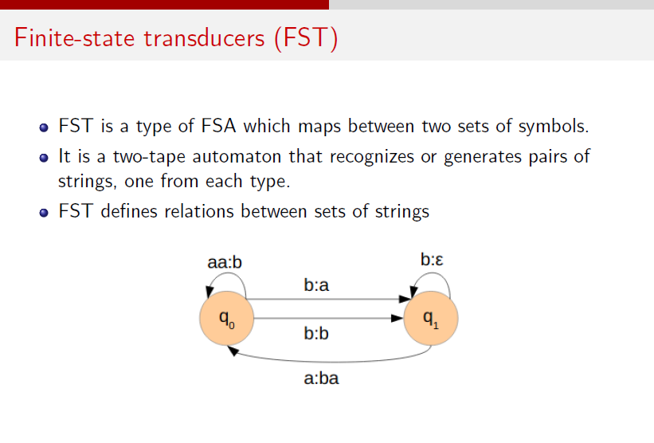

Slide 34
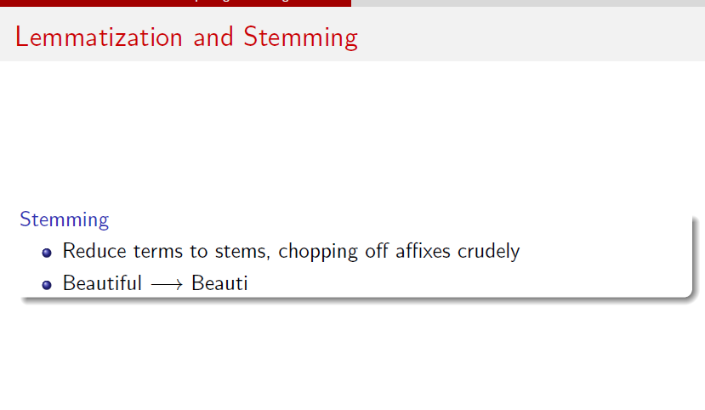

Slide 35
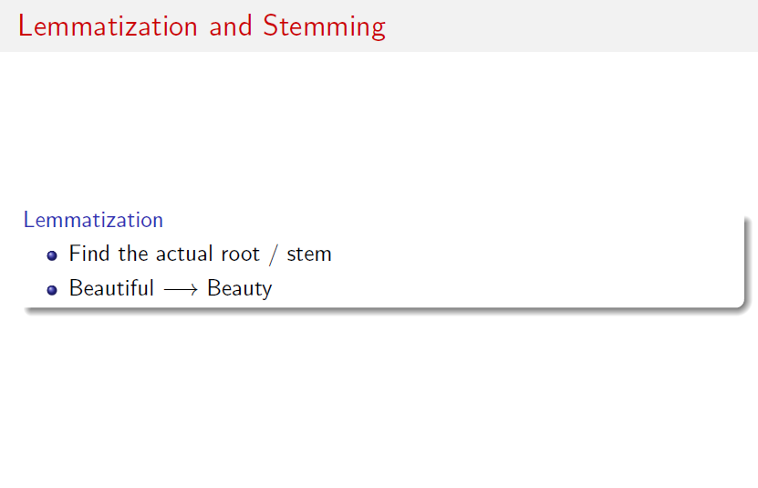

Slide 36
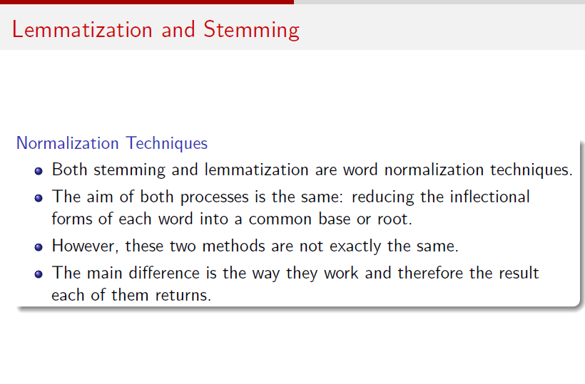

Slide 37
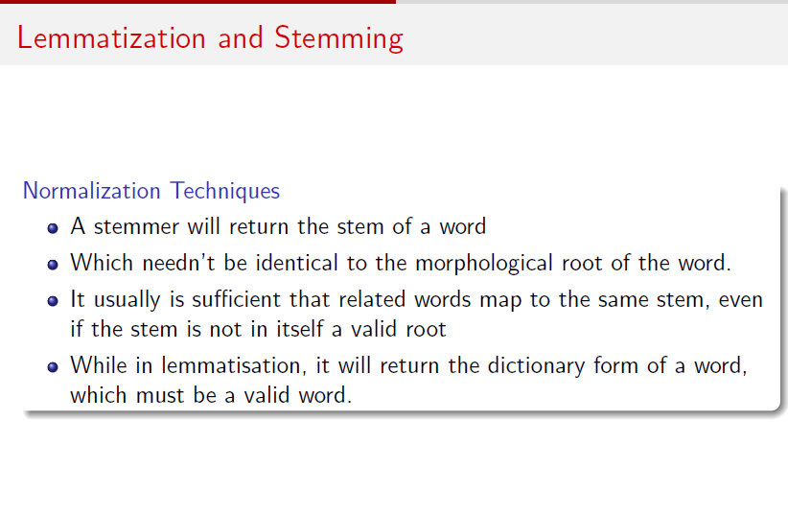

Slide 38
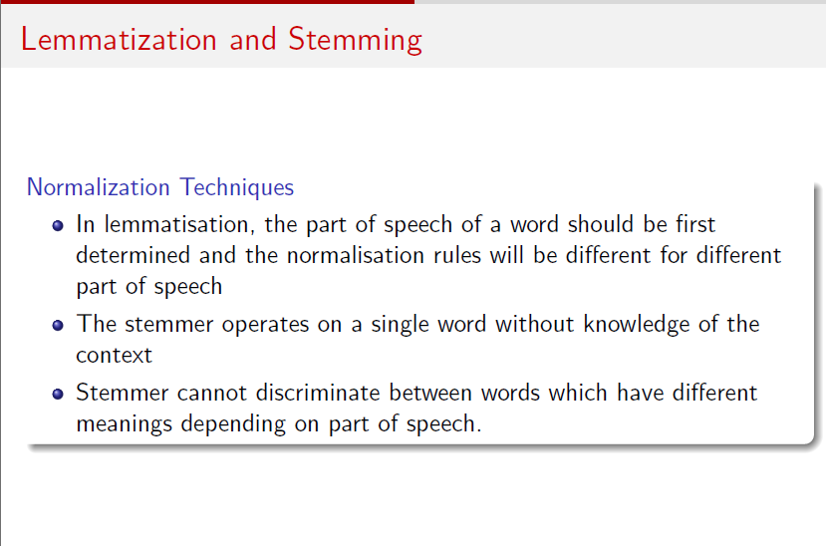

Slide 39
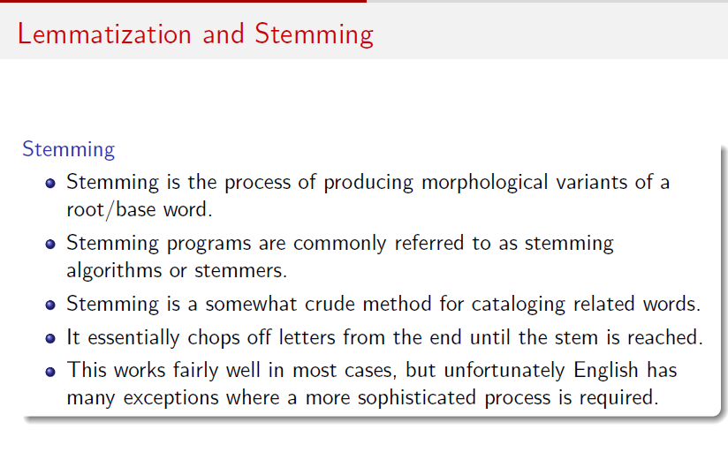

Slide 40
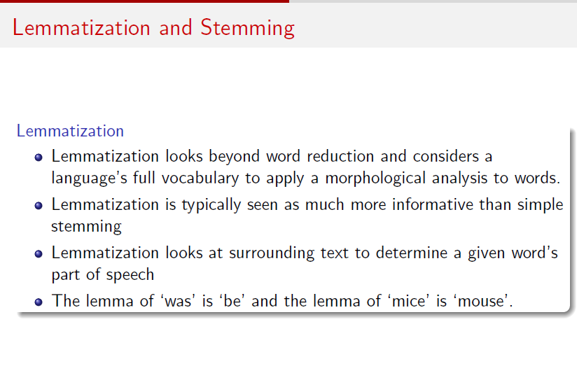
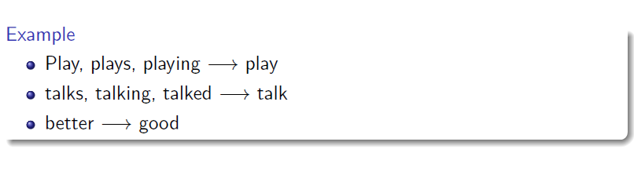

Slide 41
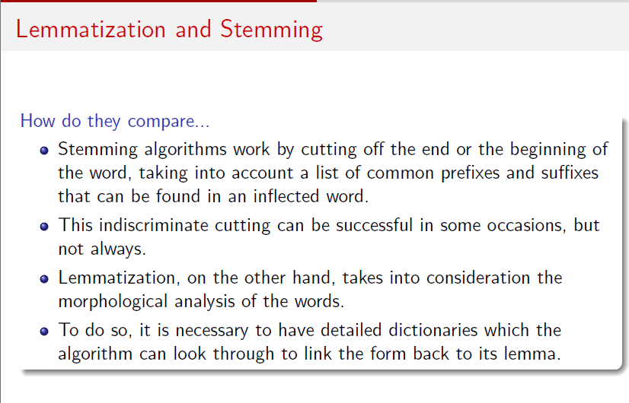

Slide 42
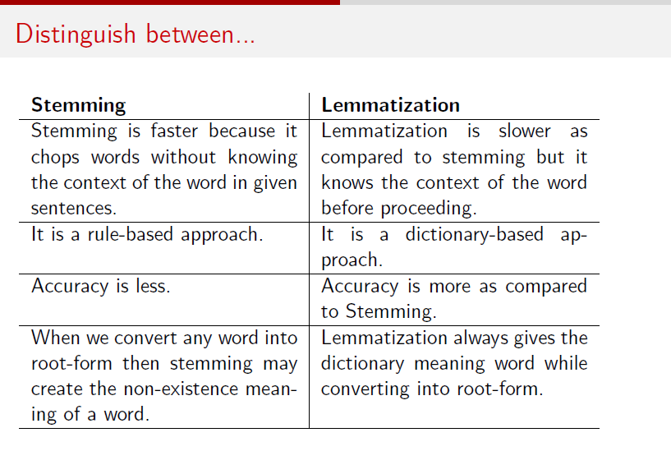
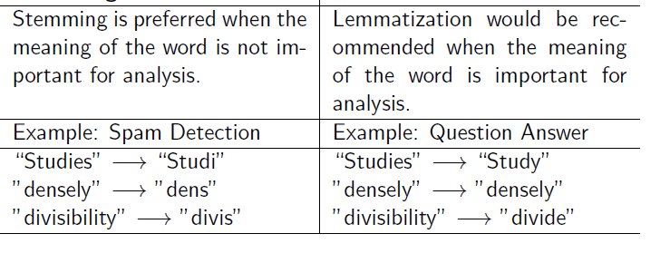

Slide 43
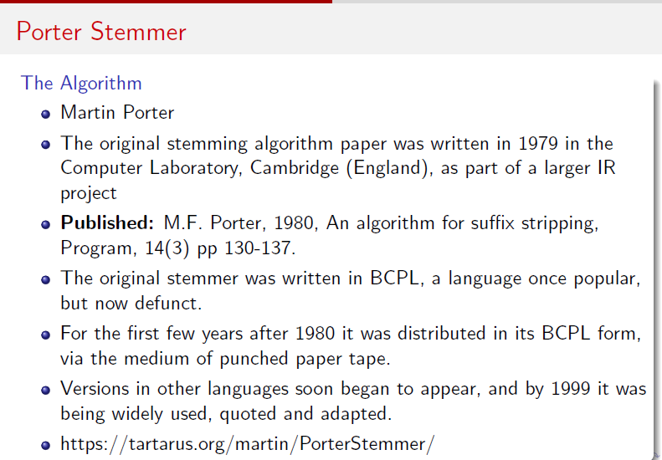

Slide 44
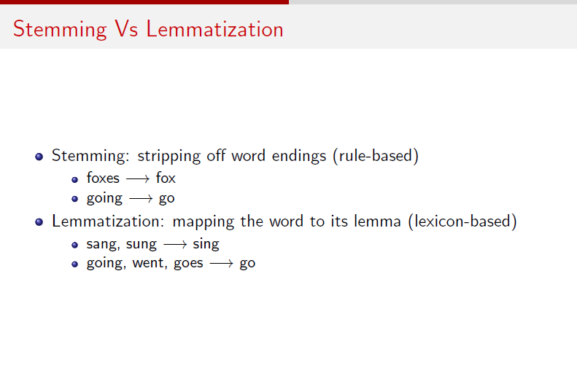

Slide 45
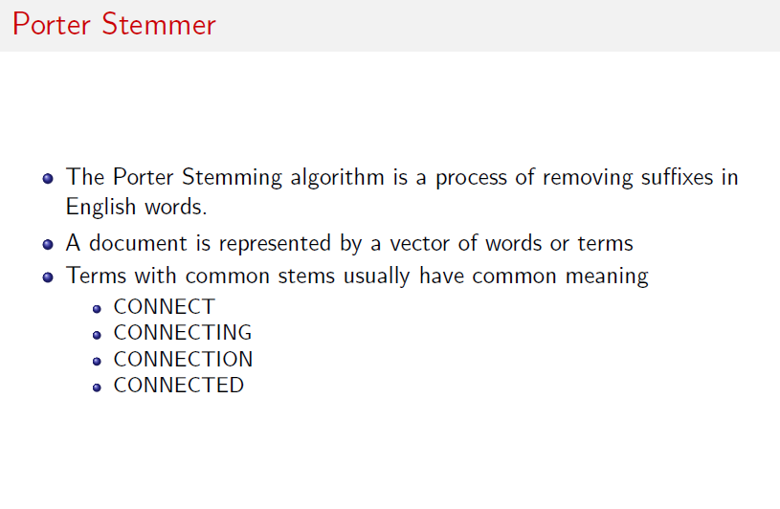

Slide 46
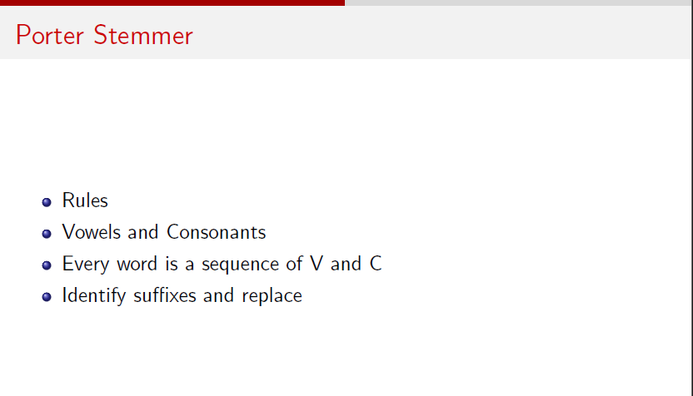

Slide 47
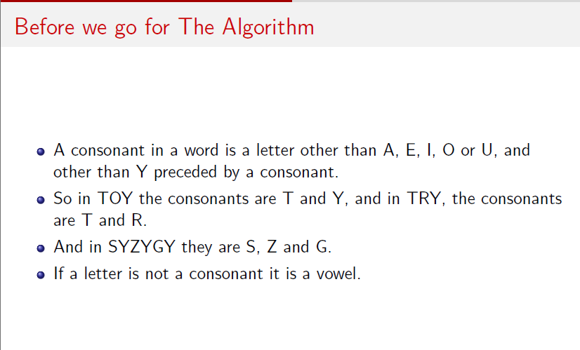

Slide 48
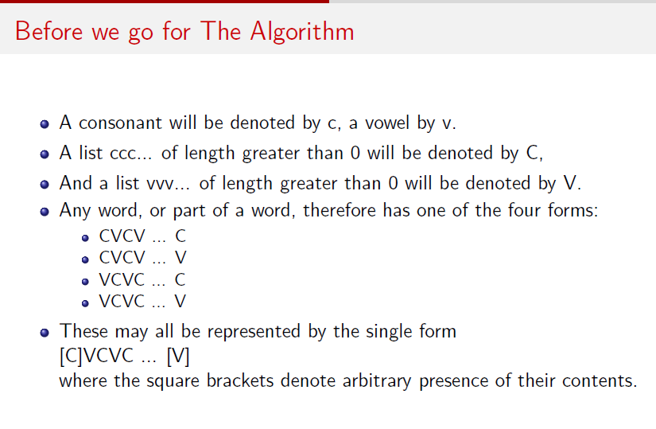

Slide 49
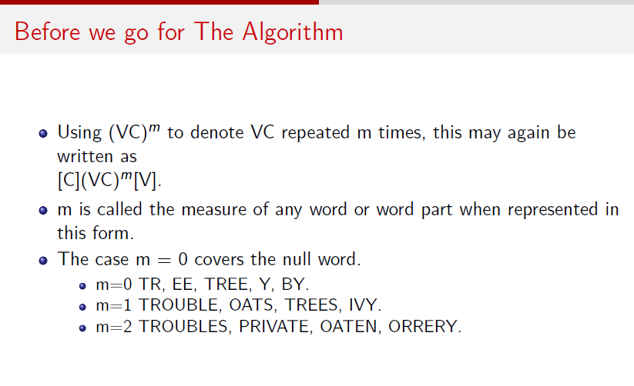

Slide 50


Slide 51


Slide 52


Slide 53


Slide 54


Slide 55


Slide 56


Slide 57


Slide 58


Slide 59


Slide 60


Slide 61


Slide 62


Slide 63


Slide 64


Slide 65


Slide 66
Snowball algorithm
Why it was created
1. The original Porter stemmer had known flaws. Over the years, Porter noticed his 1980 algorithm made some errors and mis-strippings. Snowball/Porter2 fixes these bugs and edge cases, so it's slightly more accurate.
2. It was English-only. The original Porter algorithm was hand-written just for English. There was no clean, standard way to build stemmers for French, German, Spanish, Russian, etc. Snowball provides one framework, and stemmers for many languages were written in it (it now covers ~20+ languages).
3. Rules were buried in code. In the old approach, the linguistic rules were tangled up with C code, making them hard to read, share, or verify. Snowball separates the linguistic rules (written in the clean Snowball language) from the generated code, so a linguist can read and edit the rules without touching C.

Slide 67
Snowball algorithm
What Snowball is
Snowball is a stemming framework created by Martin Porter (the same person behind the Porter stemmer) around 2001. The name has two meanings:
It's a small programming language designed specifically for writing stemming algorithms — you describe suffix-stripping rules in Snowball, and it compiles them into fast C, Java, Python, etc.
It's also the name of the stemmers written in that language — most importantly "Porter2", the improved English stemmer, plus stemmers for many other languages.

Slide 68
Snowball algorithm
 | Snowball as a language | Snowball as stemmers
What it is | A rule-writing language + compiler | The stemmers written in it
Job | Lets you describe stemming rules cleanly | Perform the actual stemming
Example | The .sbl rule file syntax | Porter2 (English), French stemmer, etc.
Analogy | The recipe language | The finished recipes/dishes

Slide 69
Rules
Vowels = a, e, i, o, u, and y when preceded by a consonant. Everything else is a consonant.
Snowball marks off two regions at the end of the word, called R1 and R2
R1 = the region after the first non-vowel following a vowel (the part of the word after the first vowel→consonant boundary).
R2 = the region after the first non-vowel following a vowel inside R1 (apply the same rule again to R1).
Example — beautiful: R1 = "iful", R2 = "ul".
Example — beauty: R1 = "y", R2 = "" (empty).
(This replaces Porter's measure m. Saying "the suffix is in R1" ≈ Porter's m>0; "in R2" ≈ m>1.)

Slide 70
Rules
A word is "short" if it ends in a short syllable AND R1 is the whole word. A short syllable = a vowel followed by a non-vowel that isn't w, x, or Y (or a vowel at the start of the word followed by a consonant). Examples of short words: bed, shed, hop.
Special exception list (do NOT stem these; return as-is or map directly):
skis→ski, skies→sky, dying→die, lying→lie, tying→tie
Words left completely unchanged: sky, news, howe, atlas, cosmos, bias, andes, and a few others.

Slide 71
Rules
Step 0 — remove apostrophe-s
Strip these suffixes if present, longest first: 's', 's, '.
John's → John
Step 1a — plurals and "-s“
Search for the longest match:
sses → ss : caresses → caress
ied, ies → i if the part before is more than one letter, else ie : ties → tie, cries → cri
s → delete, if the word contains a vowel not immediately before the s : gaps → gap, but gas → gas (unchanged)us, ss → leave unchanged

Slide 72
Rules
Step 1b — "-ed" and "-ing“
eed, eedly → ee if in R1 : agreed → agree, feed → feed (unchanged, "eed" not in R1)
ed, edly, ing, ingly → delete if the preceding word part contains a vowel, then fix up:
if the result ends in at, bl, iz → add e : fizzed → fizz... hoped → hope
if it ends in a double consonant → remove the last letter : hopping → hop
if it is now short → add e : hoped → hope, hopping → hop
Step 1c — replace "y“
y or Y → i, if preceded by a consonant and the word is more than 2 letters : cry → cri, say → say (unchanged), by → by (unchanged)

Slide 73
Rules
Step 2 — long suffix reductions (suffix must be in R1)
Replace the longest match, only if it lies in R1:
tional → tion, enci → ence, anci → ance, abli → able, entli → ent
izer, ization → ize
ational, ation, ator → ate
alism, aliti, alli → al
fulness → ful, ousli, ousness → ous, iveness, iviti → ive
biliti, bli → ble
ogi → og (if preceded by l), fulli → ful, lessli → less
li → delete (if preceded by a valid "li-ending" letter: c d e g h k m n r t)
Examples: rational → rational, conditional → condition, digitizer → digitize,
hopefulness → hopeful, quickly → quick.

Slide 74
Rules
Step 3 — more suffix reductions (suffix must be in R1)
ational → ate, tional → tion
alize → al, icate, iciti, ical → ic
ful, ness → delete
ative → delete (only if in R2)
Examples: formalize → formal, electrical → electric, goodness → good.
Step 4 — strip suffix entirely (suffix must be in R2)
Delete the longest match if it's in R2:
al, ance, ence, er, ic, able, ible, ant, ement, ment, ent, ism, ate, iti, ous, ive, ize → delete
ion → delete only if preceded by s or t
Examples: revival → reviv, allowance → allow, adoption → adopt, homologous → homolog.

Slide 75
Rules
Step 5 — final tidy-up
e → delete if it's in R2, OR in R1 and the word is not short : probate → probat,
rate → rate (unchanged)
l → delete if in R2 and preceded by l : controll → control

Slide 76
Aspect | Porter | Snowball (Porter2) | Lemmatization
Type | Rule-based stemming | Rule-based stemming | Dictionary + rule-based
Uses a lexicon? | No | No | Yes
Uses grammar / POS? | No | No | Often yes
Output | A stem (may be non-word) | A stem (may be non-word) | A lemma (real word)
Languages | English only | Many languages (20+) | Language-specific
Aggressiveness | Moderate | Moderate (slightly better) | Precise
Handles irregular forms? | No | No | Yes
Speed vs accuracy | Fast, crude | Fast, slightly more accurate | Slower, precise
Best for | Search / information retrieval | Search / IR, multilingual | Grammar, meaning, display
Example: "studies" | studi | studi | study
Example: "better" | better | better | good
Example: "was" | wa | wa | be
Example: "mice" | mice | mice | mouse

Slide 77


